Slide 1
The Ethics of AI for lawyers
Miller Becker Seminar (2024)
D. Allan Asbury, Senior Counsel
© 2024 Ohio Board of Professional Conduct

Slide 2
Artificial Intelligence
"Lawyers working with AI will replace lawyers who don’t work with AI.“
Erik Brynjolfsson, Director
Stanford Digital Economy Lab

Slide 3
What is Artificial intelligence?-

Slide 4
Artificial intelligence
Artificial Intelligence (AI) is the simulation of human intelligence in machines, enabling them to perform tasks that typically require human cognitive functions such as: learning, reasoning, problem-solving, and decision-making.
AI systems are designed to analyze data, recognize patterns, and make predictions or decisions based on that data.

Slide 5
Artificial intelligence
Traditional AI - Netflix recommendations, suggested Facebook friends, spellcheck, grammar check, Google maps, Siri, Alexa, etc.
Generative AI - is a type of artificial intelligence (AI) that can create new content based on user prompts or large datasets. This content can be in the form of text, images, videos, audio, computer code, or other media.
Notes:
Experts admit they do not completely understand how AI learns.

Slide 6
Artificial intelligence
Large Language Models (LLMs) are deep learning models that use a transformer architecture to process and generate human-like text.
The transformer architecture is made up of neural networks that work together to learn the meaning of text by analyzing relationships between words and phrases.
Notes:
Experts admit they do not completely understand how AI learns.

Slide 7
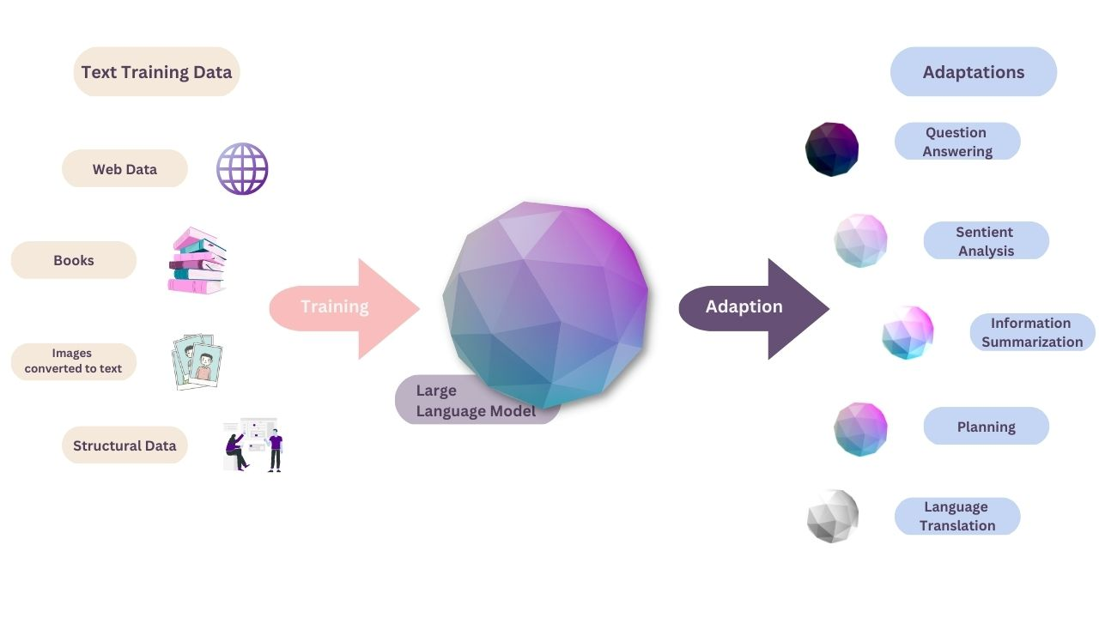
Artificial intelligence
LLMs are deep learning models that use a transformer architecture to process and generate human-like text. The transformer architecture is made up of neural networks that work together to learn the meaning of text by analyzing relationships between words and phrases.

Slide 8
Artificial intelligence
Some Key Features of LLMs:
Self attention mechanisms – allows the model to consider the entire context of a sentence to generate predictions.
Self-learning- can learn basic grammar, languages, context of language, nuance, and language patterns.

Slide 9
Artificial intelligence
Limitations of Generative AI Include:
It can be difficult to determine the source of content generated by AI.
It can be difficult to ascertain the bias of sources.
Hallucinations

Slide 10
Artificial intelligence
So, What’s Next?:
Open AI – “Strawberry” – Now
Artificial General Intelligence (AGI) – 2029+
Notes:
Using o1-preview means confronting a paradigm change in AI. Planning is a form of agency, where the AI arrives at conclusions about how to solve a problem on its own, without our help. You can see from the video above that the AI does so much thinking and heavy lifting, churning out complete results, that my role as a human partner feels diminished. It just does its thing and hands me an answer. Sure, I can sift through its pages of reasoning to spot mistakes, but I no longer feel as connected to the AI output, or that I am playing as large a role in shaping where the solution is going. This isn’t necessarily bad, but it is different.
OpenAI taught previous GPT models to mimic patterns from its training data. With o1, it trained the model to solve problems on its own using a technique known as reinforcement learning, which teaches the system through rewards and penalties. It then uses a “chain of thought” to process queries, similarly to how humans process problems by going through them step-by-step.
Strawberry
Different than LLMs
Employs Enhanced Reasoning
“Thinks” about the problem you give it before answering.
Artificial General Intelligence
Artificial general intelligence is a type of artificial intelligence that matches or surpasses human cognitive capabilities across a wide range of cognitive tasks.
Ultimate goal of Meta and Open AI

Slide 11
The legal profession & AI
AI is “[t]o powerful not to use.” - NCSC - Fundamentals of AI in the U.S. Court System (8/28/24)
Bar Exam Passage by ChatGPT-4 in the 90th percentile (2023).
44 % of all legal tasks performed by lawyers can be automated by AI. – Goldman Sachs – March, 2023
10% -21% of Law Firms using AI in some aspect of the practice of law.
Notes:
OSBA Survey

Slide 12
The Legal Profession & AI
Using AI is lawyer “key skill” – now being taught in most law schools.
Job performance may be measured by how well an employee is delegating tasks to AI.
In five years, every lawyer will have or need an “AI assistant”.

Slide 13
Artificial intelligence
“AI allows lawyers to provide better, faster, and more efficient legal services to companies and organizations. The end result is that lawyers using AI are better counselors for their clients.”
ABA, Report on House of Delegates Resolution No. 112 (Aug. 12–13, 2019)

Slide 14
ethical framework for lawyers

Slide 15
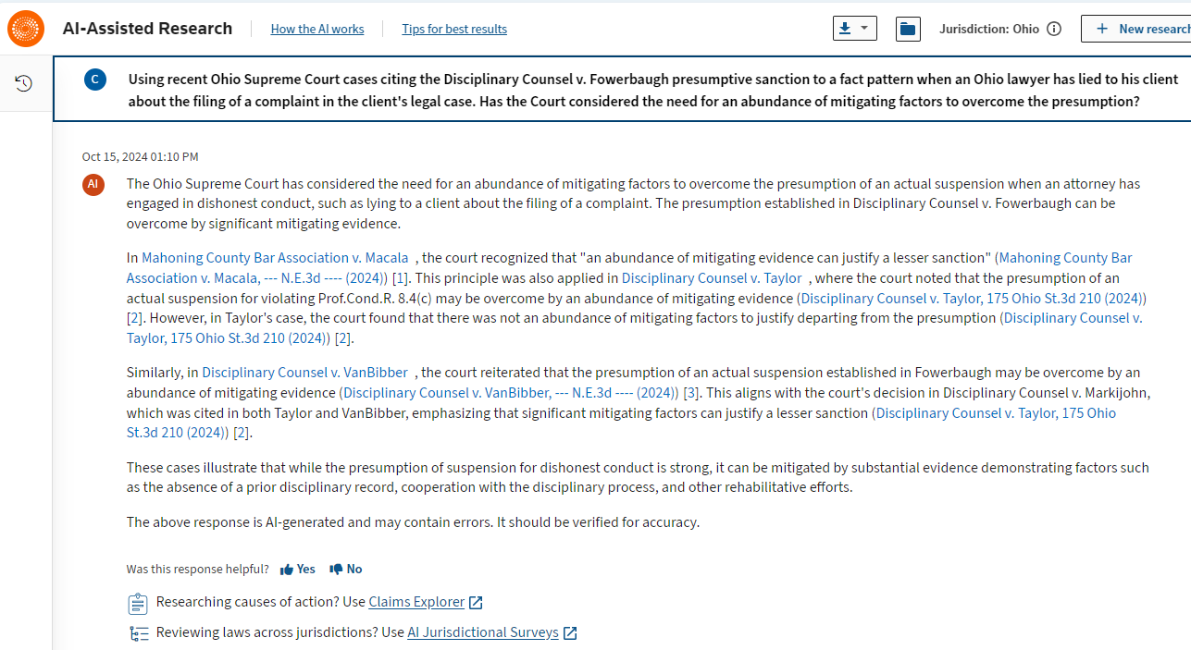
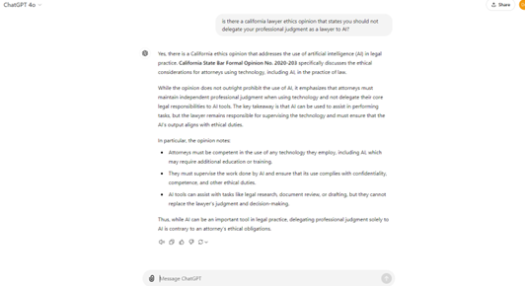
AI Tools
Westlaw and Lexis AI
CoCounsel
AI.Law
________________
Chat-GPT
Claude AI
Gemini
Bard
Notes:
Tasks Lawyers are Performing with AI
Drafting legal contracts
Other legal document creation
Document review
Legal research
Data analysis related to predicting legal outcomes
Contract analysis
CoCounsel can:
Review documents- ask questions
Prepare for depositions
Search your database of prior work product
Summarize documents and contracts and case decisions
Draft correspondence

Slide 16
AI Example – Legal Research
Prompt to Open AI – ChatGPT 4.0: “Apply the Fowerbaugh presumptive sanction to a fact pattern when an Ohio lawyer has lied to his client about the filing of a complaint in the client's legal case.”

Slide 17
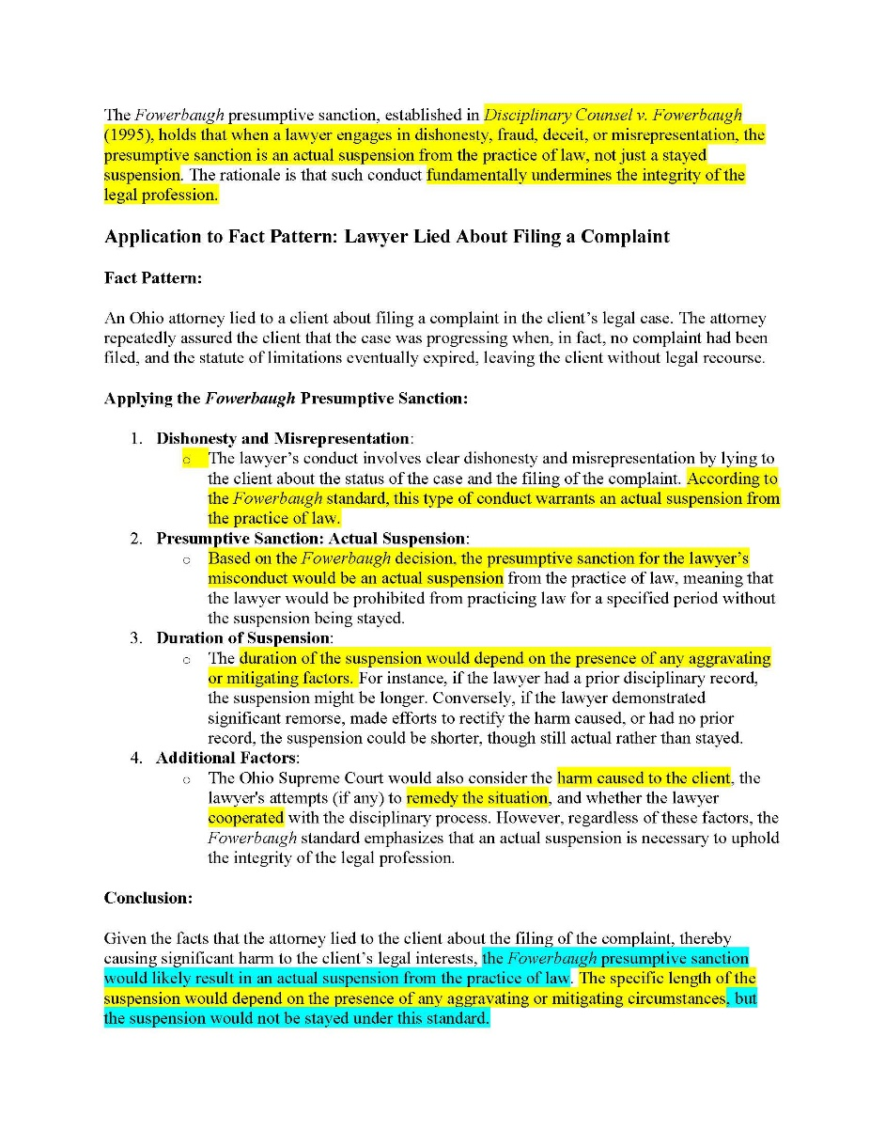

Slide 18
AI Example – Legal Research
Second Prompt: “Based on the most recent cases decided by the Supreme Court of Ohio, what sanction should be imposed for the lawyer's misconduct?”

Slide 19
AI Example – Legal Research
Likely Sanction:
Given the established presumptive sanction under Fowerbaugh for dishonest conduct, and recent disciplinary trends, the lawyer who lied to the client about filing a complaint is likely to face an actual suspension. The duration of the suspension might vary, but it is likely to be at least six months, with the possibility of a partially stayed suspension if mitigating factors are present. However, a fully stayed suspension or a mere reprimand would be unlikely unless there are very strong mitigating circumstances.

Slide 20
AI Example – Legal Research
Prompt to Westlaw AI: Using recent Ohio Supreme Court cases citing the Disciplinary Counsel v. Fowerbaugh presumptive sanction to a fact pattern when an Ohio lawyer has lied to his client about the filing of a complaint in the client's legal case. Has the Court considered the need for an abundance of mitigating factors to overcome the presumption?

Slide 21
AI Example – Legal Research
Westlaw AI
In Mahoning County Bar Association v. Macala , the court explicitly recognized that "an abundance of mitigating evidence can justify a lesser sanction"
In Disciplinary Counsel v. Taylor , the court reiterated that the presumption of suspension for violations involving dishonesty can be overcome by an abundance of mitigating evidence. However, in Taylor's case, the court found that there was not an abundance of

Slide 22
AI Example – Legal Research
Westlaw AI (cont.)
mitigating factors and thus imposed a suspension. The dissent in Taylor emphasized that the majority's determination of the presence of mitigating evidence was incorrect, underscoring the importance of substantial mitigating factors to overcome the presumption.

Slide 23
competence
Prof.Cond.R. 1.1
Competence requires the legal knowledge, skill, thoroughness, and preparation reasonably necessary for the representation.
Must keep abreast of the risks and benefits associated with relevant technology. Cmt.[8].
Ensuring AI tools are accurate, reliable, and do not compromise the quality of the representation.
Notes:
Undoubtedly, AI now qualifies as one such “relevant technology.” Similarly, Comment 5 to this Model Rule 1.1 explains that “[c]ompetent handling of a particular matter includes … use of methods and procedures meeting the standards of competent practitioners.” It is therefore arguably incumbent on lawyers to understand the extent of the AI technology available, and—if that technology becomes standard—to make use of it.
Essential for lawyers to be aware of how AI can be used in their practices.
If using it in your practice, should have a pretty comprehensive understanding of how it works, its advantages and disadvantages. If you are going to use it in your practice, but are uncomfortable, make sure to associate with someone who is competent.
Some jurisdictions have opined that 1.1 [8] requires a basic understanding of the available technology whether you are utilizing it or not,
Doesn’t require you to use the technology.
Your clients may use it, your litigation opponents may use it. Best to understand how it works.
No overreliance- not consistent with the active practice of law and application of independent professional judgment.
With AI in legal practices- at what point will your failure or refusal to use it rise to the level of a competency issue? Will you have to defend a refusal to use AI at some point.

Slide 24
competence
Must ensure that work product generated by AI is coherent, defensible, and consistent, reflecting sound legal knowledge.
A misunderstanding of AI technology can lead to problematic reliance on generative AI results.
Notes:
“An algorithm may weigh factors that the law or society deem inappropriate or do so with a weight that is inappropriate in the context presented…. AI does not understand the world as humans do and, unless instructed otherwise, its results may reflect an ignorance of norms or case law precedent.” Michigan JL -155 (2023).

Slide 25
scenario
Attorney Jennifer, a solo practitioner, takes on a complex criminal defense case involving cutting-edge forensic technology. She uses a new AI tool designed to analyze forensic evidence, but she does not understand how the tool operates or its potential limitations. Relying solely on the AI analysis, Jennifer advises her client to accept a plea deal without consulting a forensic expert or fully understanding the science behind the evidence. Later, it’s discovered that the AI tool misinterpreted the evidence, and if properly analyzed, the evidence could have exonerated the client.
Notes:
Scenario: Attorney Jennifer, a solo practitioner, takes on a complex criminal defense case involving cutting-edge forensic technology. She uses a new AI tool designed to analyze forensic evidence, but she does not understand how the tool operates or its potential limitations. Relying solely on the AI analysis, Jennifer advises her client to accept a plea deal without consulting a forensic expert or fully understanding the science behind the evidence. Later, it’s discovered that the AI tool misinterpreted the evidence, and if properly analyzed, the evidence could have exonerated the client.
Violation: Jennifer violated Rule 1.1 by failing to gain a sufficient understanding of the AI tool and not ensuring that the evidence analysis was accurate. Competence requires that attorneys understand the tools they use, including their limitations, and seek expert advice when necessary. Jennifer’s failure to understand the AI technology and rely on it without additional human oversight harmed her client's defense.

Slide 26
A). Jennifer violated her duty of confidentiality by using the AI tool to disclose sensitive client information without her client’s consent.
B). Jennifer violated her duty to investigate potential biases in the AI tool, as AI systems can sometimes reflect racial or gender biases in legal outcomes.
C). Jennifer violated her duty of competence by not fully understanding the limitations of the AI tool and relying on it without further review, leading to incorrect advice.
D). Jennifer should have relied on expert testimony rather than AI to analyze forensic evidence, as expert witnesses are more trusted in court.
Notes:
Scenario: Attorney Jennifer, a solo practitioner, takes on a complex criminal defense case involving cutting-edge forensic technology. She uses a new AI tool designed to analyze forensic evidence, but she does not understand how the tool operates or its potential limitations. Relying solely on the AI analysis, Jennifer advises her client to accept a plea deal without consulting a forensic expert or fully understanding the science behind the evidence. Later, it’s discovered that the AI tool misinterpreted the evidence, and if properly analyzed, the evidence could have exonerated the client.
Violation: Jennifer violated Rule 1.1 by failing to gain a sufficient understanding of the AI tool and not ensuring that the evidence analysis was accurate. Competence requires that attorneys understand the tools they use, including their limitations, and seek expert advice when necessary. Jennifer’s failure to understand the AI technology and rely on it without additional human oversight harmed her client's defense.

Slide 27
Independent professional judgment
Prof. Cond. 2.1
In representing a client, a lawyer shall exercise independent professional judgment and render candid advice.
Independent professional judgment refers to a lawyer's ability to make decisions and provide advice based on their legal knowledge and ethical obligations, without undue influence.

Slide 28
Independent professional judgment
Prof. Cond. 2.1 (cont.)
Lawyers should not delegate their independent professional judgment to AI. – California Advisory Opinion (2020).

Slide 29
Independent professional judgment
Prof.Cond.R. 2.1in the context of AI
A lawyer should not rely solely on AI for legal research or decision-making that may undermine their independent professional judgment.
Lawyers should approach AI as a tool that supports, not replaces, their independent judgment.
Critically assess results and work product generated by AI.
Be able to explain how AI was used to form the basis for advice or a recommendation to clients.

Slide 30
scenario
Attorney Ben represents a client in a high-stakes litigation matter. He uses an AI-powered settlement analysis tool that recommends a settlement figure significantly lower than what Ben thinks is appropriate. Without discussing the tool’s recommendation with the client or considering the specific facts of the case, Ben pushes his client to accept the AI-recommended settlement offer.
Notes:
Scenario: Attorney Ben represents a client in a high-stakes litigation matter. He uses an AI-powered settlement analysis tool that recommends a settlement figure significantly lower than what Ben thinks is appropriate. Without discussing the tool’s recommendation with the client or considering the specific facts of the case, Ben pushes his client to accept the AI-recommended settlement offer.
Violation: Ben violated Rule 2.1 by failing to exercise his independent professional judgment. Instead of assessing the merits of the case himself, he deferred to an AI tool’s recommendation, which may not have taken all relevant factors into account.

Slide 31
A). Ben relied too heavily on the AI’s recommendation without exercising his own independent professional judgment.
B). Ben violated his duty of competence by failing to consult a senior attorney before relying on the AI tool for the settlement recommendation.
C). Ben violated his duty to negotiate vigorously on behalf of his client by not pursuing additional settlement offers.
D). Ben failed to ensure the AI tool was designed in compliance with local court rules governing AI use.
Notes:
Scenario: Attorney Ben represents a client in a high-stakes litigation matter. He uses an AI-powered settlement analysis tool that recommends a settlement figure significantly lower than what Ben thinks is appropriate. Without discussing the tool’s recommendation with the client or considering the specific facts of the case, Ben pushes his client to accept the AI-recommended settlement offer.
Violation: Ben violated Rule 2.1 by failing to exercise his independent professional judgment. Instead of assessing the merits of the case himself, he deferred to an AI tool’s recommendation, which may not have taken all relevant factors into account.

Slide 32
confidentiality
Prof.Cond.R. 1.6
Duty to maintain all information related to the representation of a client confidential.
Rule 1.6 encompasses the rule of confidentiality, the attorney-client privilege, and attorney work product.

Slide 33
confidentiality
Confidentiality In the Context of AI
Do not disclose client related information to an open AI tool like Chat-GPT.
Do not disclose information that could lead to the discovery of the client.
Only use AI tools that do not share information or use prompts to learn, i.e., Westlaw and Lexis AI tools.
Review vendor specifications for contracted tools.
Notes:
Questions: Will information I provide to AI be visible to the AI provider or other third parties.
Will my interactions with AI affect answers that later users of the AI will get in a way that could reveal information I provided to AI?
Many generative AI platforms do not provide confidentiality for the prompts input into the tool or the outputs produced by it. Unless they represent otherwise, generative AI companies are likely to use these prompts for additional training of their AI models. The prompts and the responses they produce could be revealed to the general public either by accident or by specially-designed inquiries to the generative AI tool.
Some U.S. lawyers using generative AI for client work are now contracting for generative AI tools that do not use the lawyer’s prompts as further training for the model. The vendors for these tools claim that they eliminate prompts and AI tool inputs and outputs after use, so that the confidentiality of all of this information is protected. Before undertaking client work using a generative AI tool, a lawyer must understand how information submitted in a prompt will be used and shared and also where it will be stored. The data security of AI model companies and law offices using these products can put information relating to a client’s representation at risk.

Slide 34
scenario
Attorney Megan is working on a sensitive merger and acquisition deal. She uses a third-party AI contract review platform to analyze hundreds of documents, but she neglects to check whether the platform encrypts the data or has strong confidentiality protections. The platform suffers a data breach, and confidential deal terms are leaked to the public.
Notes:
Scenario: Attorney Megan is working on a sensitive merger and acquisition deal. She uses a third-party AI contract review platform to analyze hundreds of documents, but she neglects to check whether the platform encrypts the data or has strong confidentiality protections. The platform suffers a data breach, and confidential deal terms are leaked to the public.
Violation: Megan violated Rule 1.6 by failing to ensure the confidentiality of her client’s information when using a third-party AI tool. Lawyers must take reasonable steps to protect client information, especially when outsourcing tasks to AI platforms.

Slide 35
A.) Megan violated her duty to provide competent representation by using an AI tool that was not built for handling complex legal transactions.
B). Megan breached her duty of confidentiality by not confirming the AI platform’s security and confidentiality measures before uploading sensitive client information.
C). Megan did not ensure that the external AI tool complied with the law firm’s security protocols.
D). Megan should have insured the merger documents to protect against potential breaches, which would have mitigated financial liability for the firm.
Notes:
Scenario: Attorney Megan is working on a sensitive merger and acquisition deal. She uses a third-party AI contract review platform to analyze hundreds of documents, but she neglects to check whether the platform encrypts the data or has strong confidentiality protections. The platform suffers a data breach, and confidential deal terms are leaked to the public.
Violation: Megan violated Rule 1.6 by failing to ensure the confidentiality of her client’s information when using a third-party AI tool. Lawyers must take reasonable steps to protect client information, especially when outsourcing tasks to AI platforms.

Slide 36
Client communication
Prof.Cond.R. 1.4
A lawyer shall reasonably consult with the client about the means by which the client’s objectives are to be accomplished.
Duty to inform clients of the lawyer’s use of AI, include the risks and benefits? Or impliedly authorized?
Review any client instructions regarding the use of AI.
Notes:
The attorney should provide the client with sufficient information about how the attorney intends to use AI to participate intelligently in decisions concerning the representation's objectives and the means by which they are to be pursued, to the extent the client is willing and able to do so (see Comment 5 to ABA Model Rule 1.4).

Slide 37
scenario
Attorney Tom uses an AI tool to predict the likelihood of success in a medical malpractice case. The AI predicts a low chance of winning, so Tom advises his client to settle without explaining that the AI’s prediction was based solely on historical data and may not fully apply to their unique circumstances. The client, unaware of the AI’s limitations, agrees to the settlement.
Notes:
Scenario: Attorney Tom uses an AI tool to predict the likelihood of success in a medical malpractice case. The AI predicts a low chance of winning, so Tom advises his client to settle without explaining that the AI’s prediction was based solely on historical data and may not fully apply to their unique circumstances. The client, unaware of the AI’s limitations, agrees to the settlement.
Violation: Tom violated Rule 1.4 by not fully informing his client about the basis of his recommendation and the limitations of the AI’s prediction. Lawyers must ensure clients understand how AI influences legal strategies and outcomes.

Slide 38
A). Tom violated his duty of communication by not discussing the AI tool's limitations or consulting the client before recommending the settlement.
B). Tom should have conducted a mock trial to assess the potential outcome more effectively, rather than relying solely on AI predictions.
C). Tom failed to analyze the AI tool’s predictions in comparison to similar malpractice cases.
D). Tom should have referred the case to a specialist in medical malpractice instead of using an AI tool for case prediction.
Notes:
Scenario: Attorney Tom uses an AI tool to predict the likelihood of success in a medical malpractice case. The AI predicts a low chance of winning, so Tom advises his client to settle without explaining that the AI’s prediction was based solely on historical data and may not fully apply to their unique circumstances. The client, unaware of the AI’s limitations, agrees to the settlement.
Violation: Tom violated Rule 1.4 by not fully informing his client about the basis of his recommendation and the limitations of the AI’s prediction. Lawyers must ensure clients understand how AI influences legal strategies and outcomes.

Slide 39
Nonlawyer assistants
Prof.Cond.R. 5.3
Responsibility for the conduct of nonlawyers employed or contracted by the law firm.
AI tools care treated under the rule as “nonlawyer assistance.”
Notes:
These duties apply to nonlawyers “both within and outside of the law firm.” ABA Comm. on Ethics and Prof’l Responsibility, Formal Op. 498 (2021). The fact that a generative AI is managed and operated by a third-party does not obviate the need to ensure that its actions are consistent with the lawyer's own professional and ethical
obligations.
Where it is foreseeable that lawyers or nonlawyers within or retained by a firm or government agency will be using GAI in connection with a client representation, the firm should take appropriate steps to ensure that any use of GAI by lawyers and nonlawyers is consistent with the Rules of Professional Conduct.
A lawyer must satisfy herself that the third-party company’s AI program is sufficiently secure and complies with the lawyer’s obligations to ensure any client information will not be inadvertently disclosed or accessed by unauthorized individuals pursuant to Rule 1.6(c).
Nonlawyer outside assistants and provide:
• Database and document management services.
• Printing or scanning services.
• Internet-based information storage services.
AI as assistant (all lawyers will have one in next five years)
Lawyers who rely on generative AI for research, drafting, communication, and client intake risk many of the same perils as those who have relied on inexperienced or overconfident nonlawyer assistants.
Lawyers are ultimately responsible for the work product that they create regardless of whether that work product was originally drafted or researched by a nonlawyer or generative AI.

Slide 40
Nonlawyer assistants
Prof.Cond.R. 5.3 (cont.)
Must ensure the AI tool complies with ethical obligations of the lawyer.
A supervisory lawyer should ensure that the use of AI by firm employees adheres to the lawyers’ ethical obligations, e.g. training, etc.

Slide 41
Nonlawyer assistants
Prof.Cond.R. 5.3 (cont.)
Considerations to determine if a vendor’s services are compatible with the lawyer’s professional responsibility:
Experience, reputation, stability
TOS describes security measures
Information retrieval and destruction
Notes:
Sample of considerations for evaluating whether a particular third-party company’s services are compatible with the lawyer’s professional responsibility, including:
• The experience, reputation, and stability of the company; • Whether the terms of service include an agreement on how the company will handle confidential client information, including security measures employed by the company to safeguard information provided by the lawyer; and • Whether the terms of service clarify how information provided to the company will be retrieved by the lawyer or otherwise safely destroyed if not retrieved should the company go out of business, change ownership, or if services are terminated.

Slide 42
scenario
A law firm employs a sophisticated AI tool to manage e-discovery in large cases. The firm’s managing partner, Kate, assumes the AI tool can automatically identify privileged information and doesn’t provide human oversight. The AI inadvertently discloses privileged documents to opposing counsel, leading to a major setback in the litigation.
Notes:
Scenario: A law firm employs a sophisticated AI tool to manage e-discovery in large cases. The firm’s managing partner, Kate, assumes the AI tool can automatically identify privileged information and doesn’t provide human oversight. The AI inadvertently discloses privileged documents to opposing counsel, leading to a major setback in the litigation.
Violation: Kate violated Rule 5.3 by failing to properly supervise the use of the AI tool, which is considered nonlawyer assistance under the rules. Even when using advanced AI, human oversight is essential to ensure compliance with legal and ethical standards.

Slide 43
A). Kate should have personally trained all staff on AI ethics and security protocols before integrating the tool into the firm’s workflow.
B). Kate should have implemented an additional manual review process for all documents flagged by the AI tool as potentially relevant, to avoid mistakes.
C). Kate should have ensured that the AI tool's vendor had adequate protocols to flag privileged documents and supervised the tool’s use.
D). Kate should have hired a cybersecurity expert to audit the firm’s AI tools annually.
Notes:
Scenario: A law firm employs a sophisticated AI tool to manage e-discovery in large cases. The firm’s managing partner, Kate, assumes the AI tool can automatically identify privileged information and doesn’t provide human oversight. The AI inadvertently discloses privileged documents to opposing counsel, leading to a major setback in the litigation.
Violation: Kate violated Rule 5.3 by failing to properly supervise the use of the AI tool, which is considered nonlawyer assistance under the rules. Even when using advanced AI, human oversight is essential to ensure compliance with legal and ethical standards.

Slide 44
FEES
Prof.Cond.R. 1.5
Consider the reasonableness of the fee using Rule1.5(a) factors.
Lawyer may only charge a client for the actual costs incurred on the client’s behalf.
Cannot duplicate charges or inflate the lawyer’s billable hours.
AI is more efficient - client may question why lawyer did not use AI to reduce costs.
Notes:
Reminders:
Costs incurred in learning about AI, in maintaining AI provided services, and keeping up to date with changes in its use, should be considered like any other continuing legal education expense, and a part of the lawyer’s overhead.
• Lawyers charging their clients on an hourly basis cannot submit inflated bills for hours not actually spent on their case, and savings generated by using AI, like other technologies, should be passed on to the client.
• Lawyers may request that their client reimburse them for the costs incurred in using AI services, but only after first explaining the anticipated cost, and also obtaining the client’s agreement to reimburse the attorney for the expense.

Slide 45
scenario
Attorney Sam decides to use an AI tool to draft a standard employment contract for a client. The AI tool finishes the contract in minutes, but Sam charges his client for 10 hours of work because he normally would have spent that much time drafting the contract by hand. When the client later discovers how quickly the contract was generated, they feel misled and overcharged.
Notes:
Scenario: Attorney Sam decides to use an AI tool to draft a standard employment contract for a client. The AI tool finishes the contract in minutes, but Sam charges his client for 10 hours of work because he normally would have spent that much time drafting the contract by hand. When the client later discovers how quickly the contract was generated, they feel misled and overcharged.
Violation: Sam violated Rule 1.5 by inflating his fees. Lawyers must ensure that their fees reflect the actual time and effort spent on a case, even when AI makes legal tasks more efficient.

Slide 46
A). Sam violated his duty by charging the client for work not actually performed, as the AI tool completed the task in minutes rather than hours.
B). Sam violated his duty by not disclosing that AI was used in drafting the contract.
C). Sam violated his duty by using an AI tool instead of manually drafting the contract, reducing the quality of the legal work.
D). Sam violated his duty by not offering the client a discounted rate for future contracts since AI would expedite those as well.
Notes:
Scenario: Attorney Sam decides to use an AI tool to draft a standard employment contract for a client. The AI tool finishes the contract in minutes, but Sam charges his client for 10 hours of work because he normally would have spent that much time drafting the contract by hand. When the client later discovers how quickly the contract was generated, they feel misled and overcharged.
Violation: Sam violated Rule 1.5 by inflating his fees. Lawyers must ensure that their fees reflect the actual time and effort spent on a case, even when AI makes legal tasks more efficient.

Slide 47
advertising
Prof.Cond.R. 7.1
A lawyer shall not make or use a false, misleading, or nonverifiable communication about the lawyer or the lawyer’s services.
Truthful statements that are misleading are prohibited. Cmt.[2].
Misleading if it will lead a reasonable person to the conclusion for which there is no factual foundation. Cmt.[2].

Slide 48
advertising
Prof.Cond.R. 7.1 (cont.)
Lawyers may generally advertise their use of generative AI but cannot claim their generative AI is superior to those used by other lawyers or law firms.’
Notes:
Doucet LPA and AI.Law

Slide 49
advertising
Other Advertising Considerations
AI chatbots for advertising and client intake purposes.
Inform prospective clients that they are communicating with an AI program and not with a lawyer or law firm employee.
Notes:
A lawyer should be careful when using an AI chatbot for advertising and client intake purposes as the lawyer will be ultimately responsible in the event the chatbot provides misleading information to prospective clients.
To avoid confusion or deception, a lawyer should inform prospective clients that they are communicating with an AI program and not with a lawyer or law firm employee.

Slide 50
scenario
A small law firm advertises that it uses “cutting-edge AI” to guarantee faster resolution of cases compared to other firms. However, the firm’s use of AI has not measurably reduced the time it takes to resolve cases, and in some instances, the cases are prolonged due to AI errors. A prospective client hires the firm based on the misleading promise of faster results and is later disappointed when the case drags on.
Notes:
Scenario: A small law firm advertises that it uses “cutting-edge AI” to guarantee faster resolution of cases compared to other firms. However, the firm’s use of AI has not measurably reduced the time it takes to resolve cases, and in some instances, the cases are prolonged due to AI errors. A prospective client hires the firm based on the misleading promise of faster results and is later disappointed when the case drags on.
Violation: The firm violated Rule 7.1 by making a false or misleading claim in its advertisement. Lawyers may use AI, but they cannot make unverifiable claims about its impact on case outcomes or efficiency.

Slide 51
A). The firm violated the rule by making a false or misleading statement in their advertisement, as they cannot verify their claim of being the “fastest and most accurate.”
B). The firm failed to properly document the AI tool’s efficiency, resulting in an unsupported claim.
C). The firm should have explicitly stated which AI platform they were using.
D). The firm should have run focus groups to test the effectiveness of AI before making bold marketing claims about speed and accuracy.
Notes:
Scenario: A small law firm advertises that it uses “cutting-edge AI” to guarantee faster resolution of cases compared to other firms. However, the firm’s use of AI has not measurably reduced the time it takes to resolve cases, and in some instances, the cases are prolonged due to AI errors. A prospective client hires the firm based on the misleading promise of faster results and is later disappointed when the case drags on.
Violation: The firm violated Rule 7.1 by making a false or misleading claim in its advertisement. Lawyers may use AI, but they cannot make unverifiable claims about its impact on case outcomes or efficiency.

Slide 52
Candor to the tribunal
Prof.Cond.R. 3.3
A lawyer shall not knowingly make a false statement of fact or law to a tribunal or fail to correct a false statement of material fact or law previously made to the tribunal by the lawyer

Slide 53
Candor to the tribunal
Candor in the Context of AI
Lawyers have an ethical duty to ensure that legal authorities and propositions of law that are presented to a court are accurate.
Citing non-existent judicial opinions, false quotes and fake citations in filings with a court may implicate Rule 3.3.
See also Rule 3.1 – meritorious claims
Notes:
If an attorney later discovers an inaccuracy, then the attorney is required to correct the inaccuracy, and to notify the Court of any misleading statements. Without a doubt, if the Court questions the attorney’s filings that include fake cases, the attorney must be candid with the Court and explain the error. Failure to do so not only subjects the attorney to potential sanctions by the Court but may also result in disciplinary action for the attorney for noncompliance with the Rules.3
A lawyer should also check for any rules, orders, or other requirements in the relevant jurisdiction that may necessitate the disclosure of the use of generative AI.
3.1 – A lawyer cannot abrogate her responsibilities by relying on AI. Under 3.1, a lawyer cannot bring or defend, assert or controvert an issue unless there is a basis in law and fact for doing so that is not frivolous.

Slide 54
scenario
Attorney Emily files a motion citing a legal case found through an AI research tool. She later learns that the case is not from a valid legal database but was incorrectly pulled from an AI-generated legal summary. Despite knowing this, she fails to correct the error in her filing, assuming the court won’t notice.
Notes:
Scenario: Attorney Emily files a motion citing a legal case found through an AI research tool. She later learns that the case is not from a valid legal database but was incorrectly pulled from an AI-generated legal summary. Despite knowing this, she fails to correct the error in her filing, assuming the court won’t notice.
Violation: Emily violated Rule 3.3 by knowingly failing to correct a false statement to the tribunal. Even if the mistake originated from AI, lawyers have a duty to ensure that all citations and legal arguments they present are accurate.

Slide 55
A). Emily violated her duty of candor to the tribunal by failing to correct the false case citation once she became aware of the issue.
B). Emily should have hired a law clerk to double-check the AI tool’s research, reducing the chances of such errors.
C). Emily should have included a disclaimer in her motion indicating that the research was partially conducted by AI, to inform the court of possible discrepancies.
D). Emily violated her duty by not conducting thorough manual research before filing the motion.
Notes:
Scenario: Attorney Emily files a motion citing a legal case found through an AI research tool. She later learns that the case is not from a valid legal database but was incorrectly pulled from an AI-generated legal summary. Despite knowing this, she fails to correct the error in her filing, assuming the court won’t notice.
Violation: Emily violated Rule 3.3 by knowingly failing to correct a false statement to the tribunal. Even if the mistake originated from AI, lawyers have a duty to ensure that all citations and legal arguments they present are accurate.

Slide 56
Candor to the tribunal
Best Practices
Review AI output from both commercial and free resources.
Verify sources, citations, and quotes.
If relying on law clerks or associates, review all filings for accuracy.
Use reliable sources- Westlaw, Lexis, Decisis, etc.

Slide 57
Citation and Quote Fabrication Using AI
Potential Rule Violations
Lawyer Competence – RPC 1.1
Meritorious Claims – RPC 3.1
Candor to tribunal – RPC 3.3
Conduct prejudicial to the administration of justice – RPC 8.4(d)
Rule 11 concerns

Slide 58
Citation and Quote Fabrication
Disciplinary cases and sanctioned lawyers
People v. Crabill (Colorado, 2023)
In re Neusom (M.D. FL, 2024)
Mata v. Avianca, Inc. (S.D. N.Y, 2024)
Park v. Kim (United States 2d. Cir., 2024)
Smith v. Farwell (Mass., 2024)
Notes:
Judges found the citation/quote issues, not opposing counsel, in the majority of cases.

Slide 59
questions

Slide 60
ethics assistance
Rick Dove: rick.dove@bpc.ohio.gov
Allan Asbury: allan.asbury@bpc.ohio.gov
Website: www.bpc.ohio.gov
Telephone: 614-387-9370

Slide 61
AI Ethics Pitfalls for Judges and Magistrates
Miller Becker seminar
2024
David Hejmanowski, Judge
Delaware County Probate/Juvenile Court

Slide 62
Rule 1.2 Confidence in the Judiciary
A judge shall act at all times in a manner that promotes public confidence in the independence, integrity, and impartiality of the judiciary, and shall avoid impropriety and the appearance of impropriety.

Slide 63
NCSC AI Guidance (8/2024)

Slide 64
Competence to Preside

Slide 65
Competence to Preside

Slide 66
NCSC Guidance

Slide 67
NCSC Guidance

Slide 68
State Bar of Michigan

Slide 69
West Virginia Adv. Op. 2023-22

Slide 70
Competence to Preside

Slide 71
Competence to Preside

Slide 72
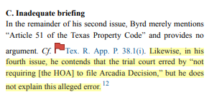
Byrd v. Woodland Springs (Texas, 2024)

Slide 73
Rule 2.3 Bias, Prejudice and Harassment
(A) A judge shall perform the duties of judicial office, including administrative duties, without bias or prejudice.
(B) A judge shall not, in the performance of judicial duties, by words or conduct manifest bias or prejudice, or engage in harassment, including but not limited to bias, prejudice, or harassment based upon race, sex, gender, religion, national origin, ethnicity, disability, age, sexual orientation, marital status, socioeconomic status, or political affiliation, and shall not permit court staff, court officials, or others subject to the judge’s direction and control to do so.

Slide 74
Connecticut Judicial Branch

Slide 75
New Jersey Supreme Court

Slide 76
Rule 2.7 Responsibility to Decide
A judge shall hear and decide matters assigned to the judge, except when disqualification is required by Rule 2.11 or other law.

Slide 77
West Virginia Adv. Op. 2023-22

Slide 78
South Dakota Supreme Court

Slide 79
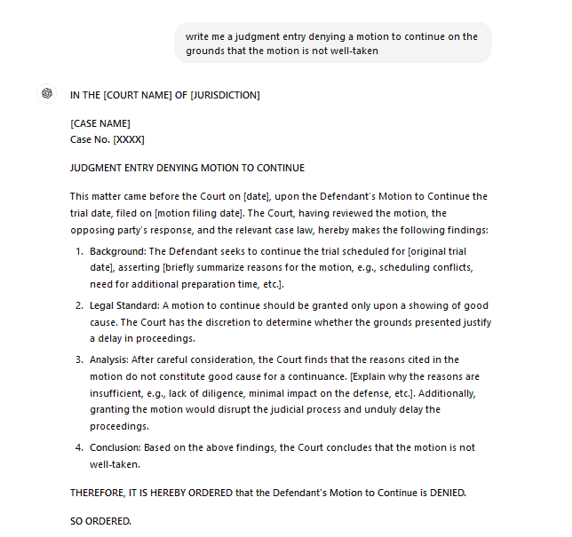
Rule 2.7 Responsibility to Decide

Slide 80
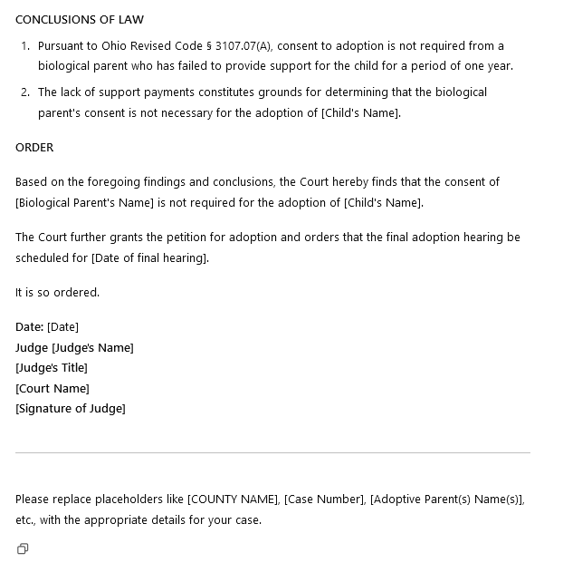
Rule 2.7 Responsibility to Decide

Slide 81
NCSC Guidance

Slide 82
Rule 2.12 Supervisory Duties
(A) A judge shall require court staff, court officials, and others subject to the judge’s direction and control to act in a manner consistent with the judge’s obligations under this code.
(B) A judge with supervisory authority for the performance of other judges shall take reasonable measures to ensure that those judges properly discharge their judicial responsibilities, including the prompt disposition of matters before them.

Slide 83
Rule 2.15 Responding to Misconduct
(A) A judge having knowledge that another judge has committed a violation of this Code that raises a question regarding the judge’s honesty, trustworthiness, or fitness as a judge in other respects shall inform the appropriate authority.
(B) A judge having knowledge that a lawyer has committed a violation of the Ohio Rules of Professional Conduct that raises a question regarding the lawyer’s honesty, trustworthiness, or fitness as a lawyer in other respects shall inform the appropriate authority.

Slide 84
NCSC Guidance

Slide 85
Rule 4.3 Campaign Communications
During the course of any campaign for nomination or election to judicial office, a judicial candidate, by means of campaign materials, including sample ballots, advertisements on radio or television or in a newspaper or periodical, electronic communications, a public speech, press release, or otherwise, shall not knowingly or with reckless disregard do any of the following:
(A) Post, publish, broadcast, transmit, circulate, or distribute information concerning the judicial candidate or an opponent, either knowing the information to be false or with a reckless disregard of whether or not it was false;

Slide 86
Advising Clients – NCSC Guidance

Slide 87
Advising Clients – NCSC Guidance

Slide 88
Hypothetical 1
Judge Harper presides over a civil case involving a complex contract dispute between two companies. The case involves an enormous amount of technical and financial data, making it difficult to sift through the evidence. To assist with the decision-making process, Judge Harper decides to rely heavily on an AI system that analyzes legal precedents, interprets contract clauses, and provides a recommended judgment based on the data input. As the trial progresses, Judge Harper receives the AI's recommended judgment, which strongly favors one party. Rather than reviewing all the evidence or writing her own opinion, Judge Harper adopts the AI’s recommendation in full, issues the judgment, and closes the case without significant independent analysis or personal deliberation.

Slide 89
Hypothetical 1
Question:
Has Judge Harper violated Rule 2.7 (Responsibility to Decide) of the Code of Judicial Conduct by relying on the AI's recommendation to make her final decision?

Slide 90
Hypothetical 2
Judge Taylor is presiding over a high-profile criminal case where the defendant is facing sentencing for multiple non-violent offenses. In an attempt to make an informed decision, Judge Taylor uses a cutting-edge AI sentencing tool that predicts the likelihood of recidivism (the tendency of the defendant to reoffend) based on data from thousands of similar cases. The AI tool suggests a much longer sentence than what the prosecution or defense recommends. The tool uses proprietary algorithms, which neither the judge nor the legal teams fully understand, and the underlying data is not available for review. Judge Taylor, without further questioning the tool's recommendation or considering other evidence, sentences the defendant based primarily on the AI's suggestion, despite the defense presenting mitigating factors such as the defendant’s personal circumstances, lack of prior criminal history, and clear signs of rehabilitation.

Slide 91
Hypothetical 2
Question:
What potential violations of ethical standards has Judge Taylor committed in this scenario?

Slide 92
Hypothetical 3
Judge Davis is overseeing a complicated patent infringement lawsuit between two tech companies. To help manage the complexity of the case, Judge Davis begins using a sophisticated AI system designed to assist with legal research, analyze arguments, and suggest relevant case law. During the trial, the AI system automatically pulls in additional data about one of the parties, including financial information that was not introduced as evidence by either party. The AI system generates a report that highlights potential weaknesses in that party's case based on this extraneous data. Judge Davis reviews the AI's report privately, without notifying the attorneys for either party, and it influences his thinking as he prepares for the next phase of the trial.

Slide 93
Hypothetical 3
Question:
Did Judge Davis violate Rule 2.9 (Ex Parte Communications) of the Code of Judicial Conduct by reviewing the AI's report, which included data not introduced by the parties?

Slide 94
Hypothetical 4
Judge Carson is known for being a tech-savvy judge and has recently integrated an AI tool into his courtroom to assist with legal research, evidence review, and even sentencing recommendations in criminal cases. The AI tool was developed by a private technology company, which heavily promotes the product to the legal community and often markets its use in Judge Carson's courtroom as a key feature of its promotional materials. During a high-profile trial, the media begins to report that Judge Carson is "outsourcing justice" to AI, implying that he relies too much on technology and questions whether the decisions in his courtroom are truly independent. The public becomes concerned that Judge Carson may not be fully exercising his own judgment and that the integrity of his decisions is compromised by the influence of the technology company that developed the AI system.

Slide 95
Hypothetical 4
Question:
Has Judge Carson potentially violated Rule 1.2 (Promoting Public Confidence in the Independence and Integrity of the Judiciary) of the Code of Judicial Conduct by heavily relying on AI and allowing the technology company to promote the use of its product in his courtroom?

Slide 96
Hypothetical 5
In a civil lawsuit involving a large corporation and a small business, Judge Thompson uses an AI system to analyze complex financial data presented by both parties. The AI, which is known for its speed but has occasionally been criticized for favoring large entities, recommends a judgment in favor of the corporation. Judge Thompson, pressed for time, adopts the AI’s recommendation without further review.

Slide 97
Hypothetical 5
Question:
Did Judge Thompson act fairly and impartially in using the AI’s recommendation as the basis for her judgment?

Slide 98
Hypothetical 6
Judge Laura Franklin is an experienced judge in a busy state trial court, presiding primarily over civil and criminal cases. Recently, the court adopted a new AI-based tool called "Evidentia" to help judges and legal staff manage and review large volumes of case materials. Evidentia is designed to analyze evidence, summarize documents, and flag potentially relevant information based on its algorithms. The tool has been marketed as a way to help judges work more efficiently, particularly in complex cases involving extensive digital evidence. Judge Franklin has limited experience with technology, though she has participated in basic training sessions on Evidentia offered by the court. Despite this, she feels uncomfortable using the tool and doesn't fully understand how it works or how it reaches its conclusions. She prefers to rely on her traditional legal research methods and the assistance of her clerks for document review.

Slide 99
Hypothetical 6
Judge Franklin is assigned to a case involving a business dispute between two technology companies. The case involves thousands of pages of technical documentation, emails, and digital records. Both parties have submitted extensive evidence, including metadata and digital communications that are central to the dispute. Due to the volume of evidence, Judge Franklin's clerk suggests using Evidentia to help identify key documents and flag important evidence for review. However, when it comes time to make a ruling, Judge Franklin uses her traditional methods, manually reviewing the evidence and consulting her clerk for assistance. However, she misses several important documents flagged by Evidentia, which the defense later brings up during an appeal, arguing that Judge Franklin's failure to properly utilize the AI tool resulted in an incomplete review of the evidence.

Slide 100
Hypothetical 6
Question:
Under Rule 2.5 of the Code of Judicial Conduct, what should Judge Franklin have done to fulfill her duty of competence?

Slide 101
Questions?

Slide 102
Contact Info:
David Hejmanowski, Judge
Delaware County
Probate/Juvenile Court
dhejmanowski@co.delaware.oh.us
740-833-2600

